Slide 1
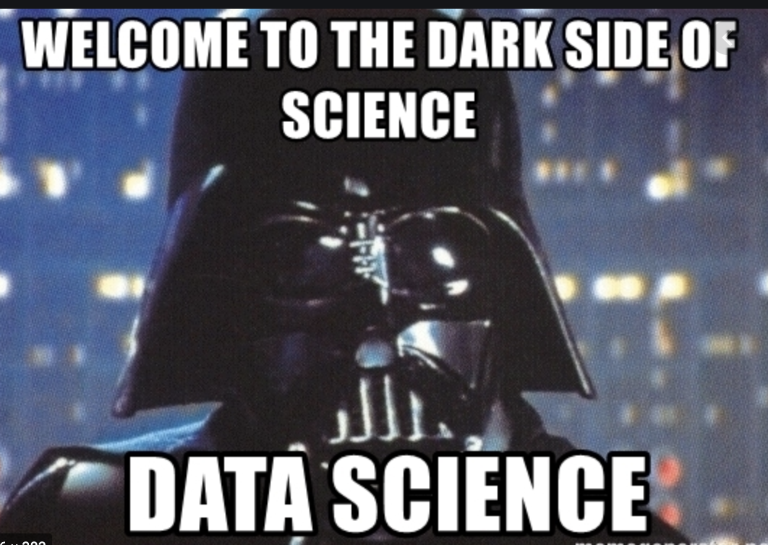
Data Science is Much More than Predicting the Future
Nakul Bajaj

Slide 2
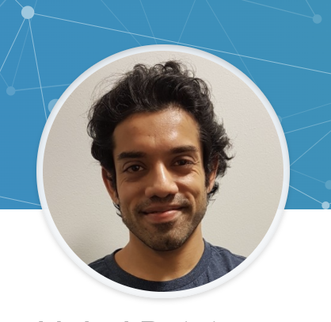
ABOUT ME
https://www.linkedin.com/in/nakul-bajaj-707b7649/
University
Data Engineering Nano Degree (Udacity)
Masters of Business Information Systems (2015-2017)
Business Analytics Specialisation
Business
Family Business 2 Years
Employment Experience
~ 4 Years 7 Months ANZ
11 Months YellowfinBi
Competition
IBM Watson Datathon
Data Science/Analytics Experience
Front end customer analytics app building with react
Big Data Analysis (Google Cloud Bigquery OLAP)
Airflow data pipelines
Python reporting automation
Machine learning for data insights
Kubernetes application development
Etherium powered blockchain
Certifications
Google Cloud Data Engineer
Some datacamp courses
Airflow, docker and kubernetes, blockchain courses on Udemy

Slide 3
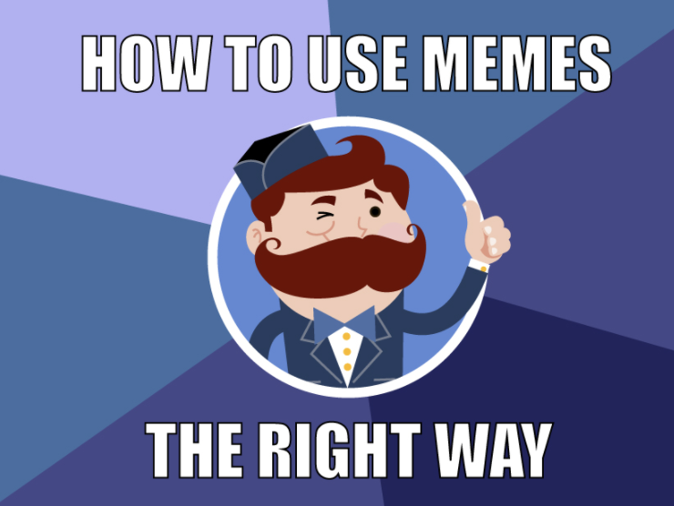
Outline
Find your why
Kick start plan and action
Decide where to start or transfer
Skill match and skill building
Setting and tailoring goals
Understanding and overcoming common challenges
Data Science pathways
Data Science Tool Box
Python vs Built tools
Jupyter notebooks are not production ready
Data Science Resources

Slide 4
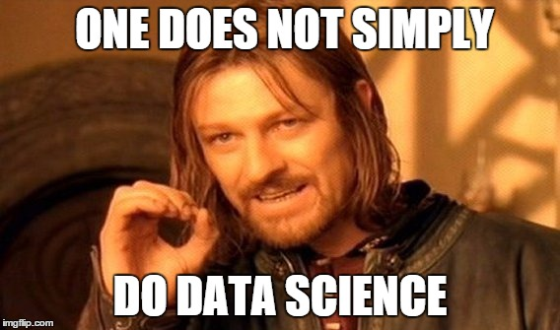
WHY DATA SCIENCE OR ANALYTICS
Passion?
Money?
Cool Career?
Curious?
Find data science problems interesting?
Want to make a difference in the world?
Pathway to settle in Australia?
Too late to change?

Slide 5
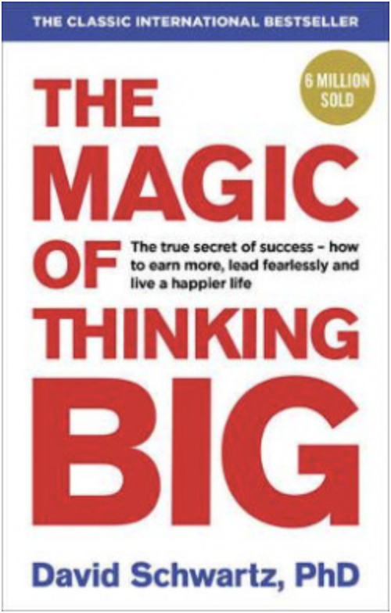
WHEN AND WHERE TO START
As soon as possible
Learn on the job
Attitude is the most important thing
Cure Yourself of Excusitis
My health is coming in the way
My age doesn’t favour me
Others are smart
Luck is against me
Participate in competitions, you will learn along the way
Datathons
Kaggle

Slide 6
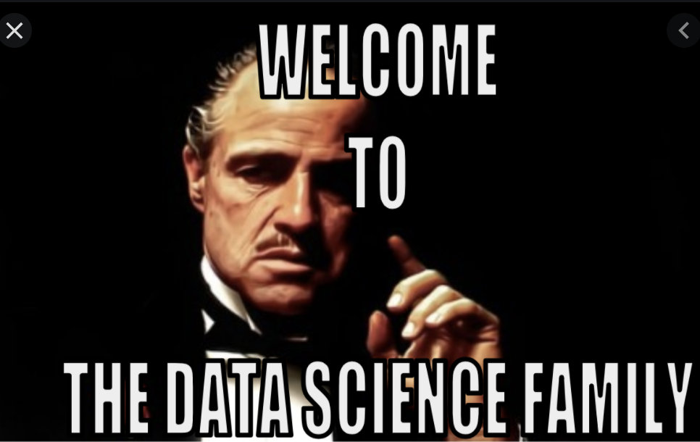
HOW TO START
Research the jobs
Note down the common skills
Cross match with what you have
Build others
Online courses
Projects
Internships
Pod casts (great for soft skills and direction)
Network
Join a university club
Attend meetups
Get a mentor (university, job, meetups)

Slide 7

WHERE TO GO
Start in a corporate
More options
Its easier
Start ups may not suit everyone at start
Highly disruptive environment
Extensive skill set is required
Faster output

Slide 8
DAY TO DAY WORK
Understanding data
SQL, Python (pandas, numpy, scipy)
Automating reports
Apps
Javascript (React) - Frontend
Python, Node, Dotnet – Backend
Data Engineering
Airflow pipelines
DBT (Data Build Tool)
Spark/Apache Beam
Custom pipelines
Infrastructure
Kubernetes/Docker/Container Service
VM (Virtual Machine)
Data Insights
Powered by machine learning (Python, Sql, Bigquery)
Random forest (feature selection)
Logistic/Linear Regression (feature selection, prediction)
Clustering (customer segmentation)
Advanced customer analytics
Loyalty Analysis
Survival modelling
Churn
Peer Analysis

Slide 9
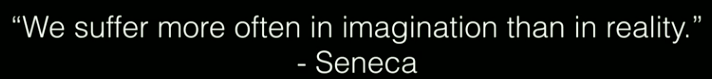
CHALLENGES OUTCOMES
Lack of motivation
Worried about the future https://www.ted.com/talks/tim_ferriss_why_you_should_define_your_fears_instead_of_your_goals?language=en
There is so much to learn, don’t know where to start
Limited hours in the day
Set goals
Long term/Short term
Hobbies
Act
Ticking boxes help
Help others (boosts oxytocin and confidence)
Prioritise based on goals
Plan your day
Busy is good

Slide 10
SET GOALS IT HELPS
https://www.getstoryshots.com/books/the-magic-of-thinking-big-summary/#Chapter_12_Use_Goals_to_Help_you_Grow
Plans change, goals may not
How to become data scientist may change, to become one may not
Once you worked out above work backward
There are different ways of skinning a cat
1 million savings, means saving 50 K for 20 years or 40K for 10 years in high investment account
Make sure your goals are bigger
If you first thought of retiring in 20 years, think 10
If you want to be a teacher, aim for becoming a principal
How many you know who aimed for pass and got HDs?

Slide 11
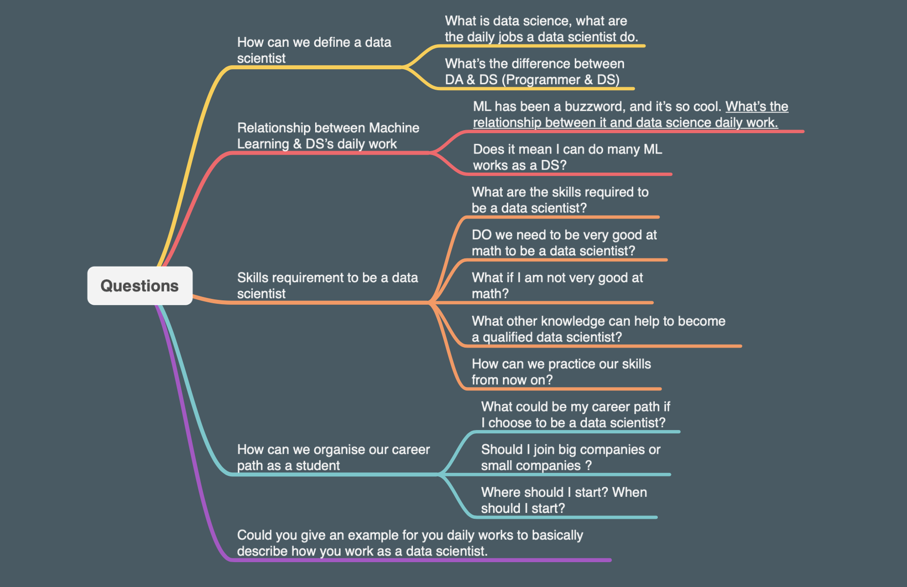
Similar Questions and Doubts: Data Science Meetup to the Rescue
https://www.dropbox.com/sh/aw77sg0d7lgg9gu/AAC4LUBDsLJuw_5y7UiWNmMOa/Week7_social_club_with_Yuval_Phil_Felipe.mp4?dl=0

Slide 12

BRINGING IT TOGETHER
Found my why
Started early with internship and datathon
Built extra skills on the side
Found a job in corporate
Learnt on the job
Facing recurring challenges and over coming them with goals and action
Setting right and ambitious goals, and getting synced with my why

Slide 13
Avinash Landing a job in ANZ

Slide 14
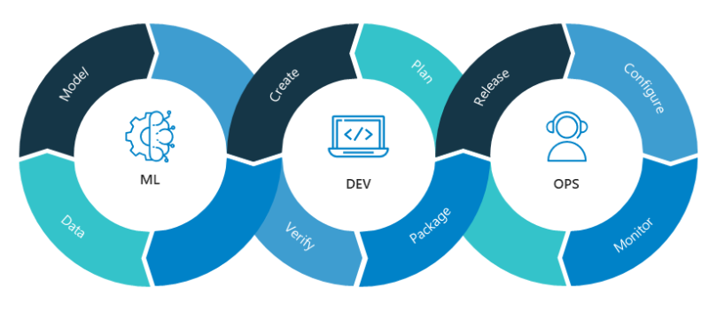
Part 2: Roles, Toolbox, Python and Jupyter Data Scientist vs Citizen Data Scientist
Data Engineer
Brings data to the data scientist
Ensures quality is ensured, and data is provided in the right place and the right format and in the right time
Build and provide additional features to data scientists
Data Analyst
Does lot of data analysis, and provide insights to business
Machine Learning Engineer (MLOPS)
Ensures algorithm built by a data scientist can run successfully in real life scenarios (production)
Ensures model quality is maintained
Provide a feature store
Automates ML build and deploy
Data Scientist
Exploratory analysis
Data Cleaning
Data Enrichment (Feature Engineering)
Model Training/Validation
Model Comparison
Model Tuning
Analytics Engineer (Role Description link)
Provides clean data to end users
Models data in a way that could be utilised by data scientists, business analysts, etc
Transforming, testing, deploying, and documenting data

Slide 15
Data Science Toolbox
Python (Numpy, Pandas, Scikit Learn) – Basic
Pytorch, TensorFlow, Keras (Reduce your boiler plate code) Learn the difference
Sql
Pipeline building/Orchestration (Airflow, Apache beam, DBT, Luigi, etc)
Some popular ones
Application Development (Javascript), Flask or Django or Dash (Python)
Frontend (Data visualisation layer)
Backend (
Api to interact with database or get predictions from your model
Data store (DB, File storage system)
Shipping your model
Containerisation
Model governance (MLOPS)

Slide 16
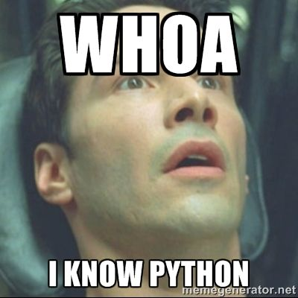
Python vs Built Tools
Built tools are good if use case is very specific
Different tools for different use cases
Business needs grow, can the tool grow with it
There is a cost associated with licencing
Python and majority of tooling around python is open sourced
You have more control
Starting and development cost is just time
More than machine learning
Front end
Backend
Pipeline
Day to day Automation
Close to C and C++ performance when using compiled libraries or building using cython

Slide 17
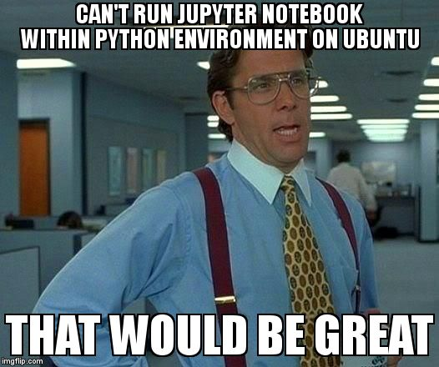
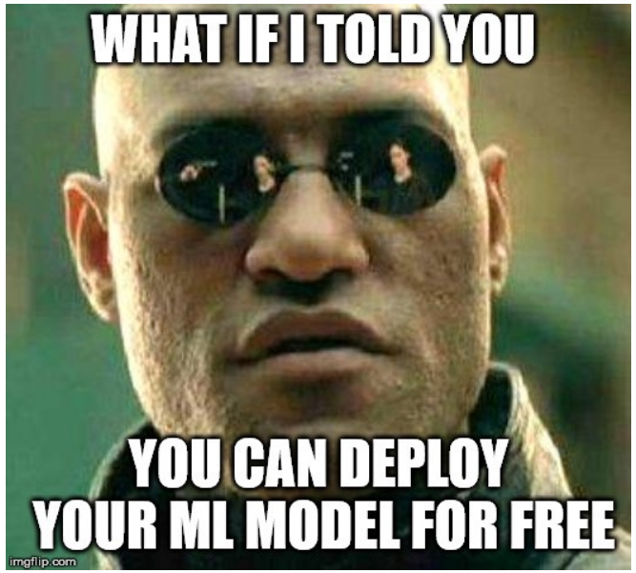
Jupyter is just a playground

Slide 18
Data Science Resources
Meetups
https://www.meetup.com/en-AU/Brisbane-Data-Science-Meetup/
https://www.meetup.com/en-AU/Data-Science-Melbourne/
https://www.meetup.com/en-AU/Machine-Learning-AI-Meetup/
Podcasts
https://www.datafuturology.com/
Other popular podcasts
Books
Machine Learning with Tensorflow - Chris Mattmann
Machine Learning Bootcamp - Alexey Grigorev + Podcast : Podcast episode
Analytics at Work
Youtube channels (Find one or few)
Online Platforms
Career progression (Udacity Nanodegrees)
For specific tools and specific algorithms, web development, cloud courses (Udemy, Coursera)
Small to the point courses (Data Camp) 4-5 hours, good getting started and applied courses (Libraries in tutorials don’t have versioning)
Linkedin Leaders
https://www.linkedin.com/in/felipe-flores-analytics
https://www.linkedin.com/in/dralexantic/
https://www.linkedin.com/in/stevenouri/
https://www.linkedin.com/in/alliekmiller/
https://www.linkedin.com/in/andrewyng/
Get a Medium membership (50$ a year)

Slide 19
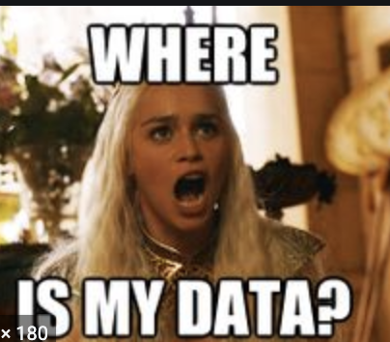
Q & A

